Slide 1
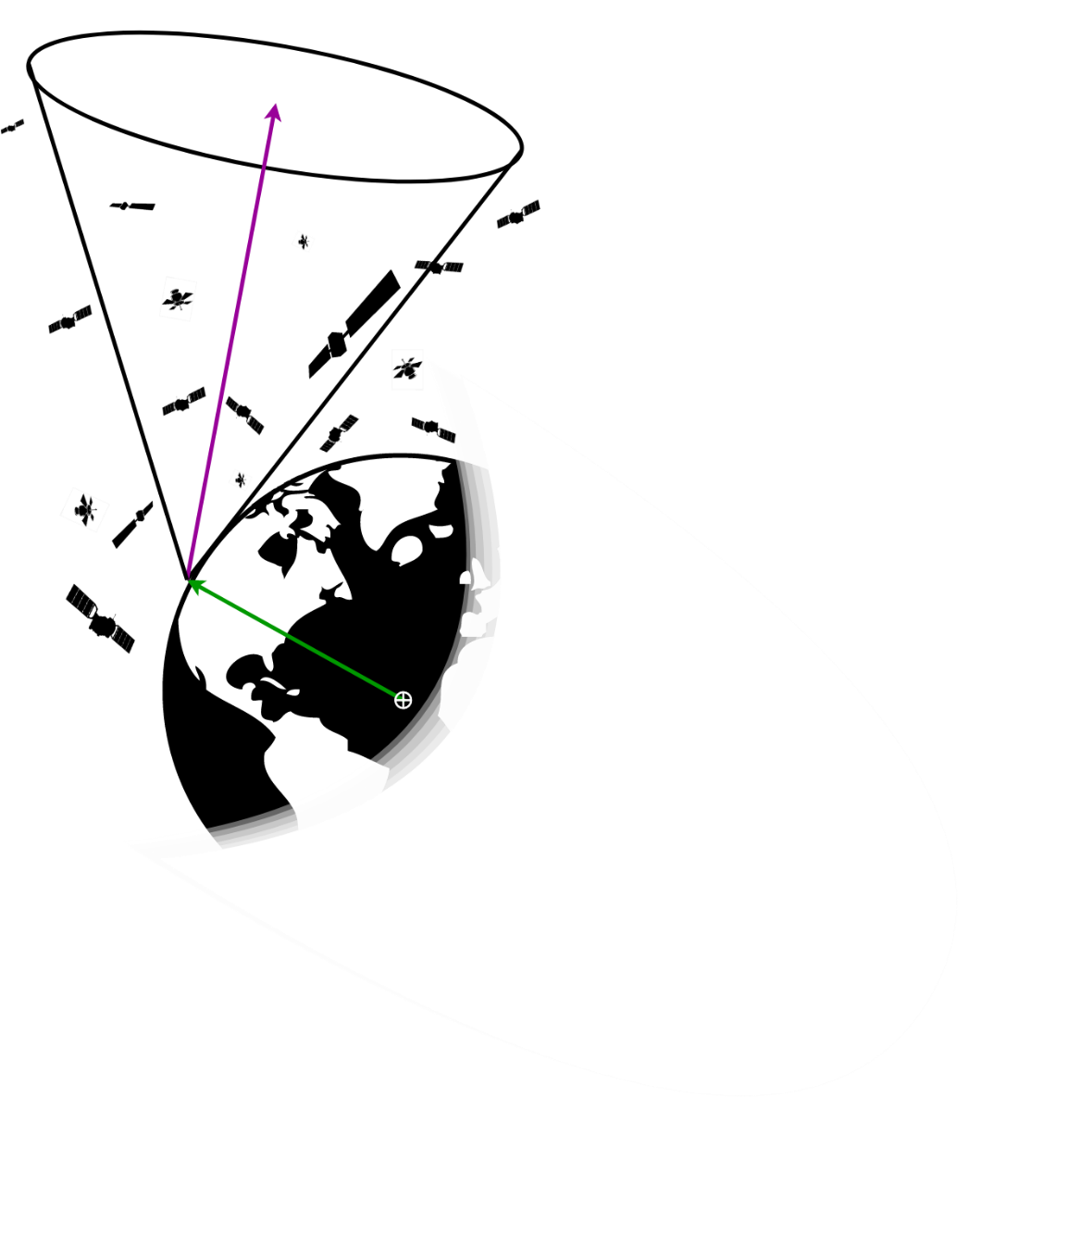
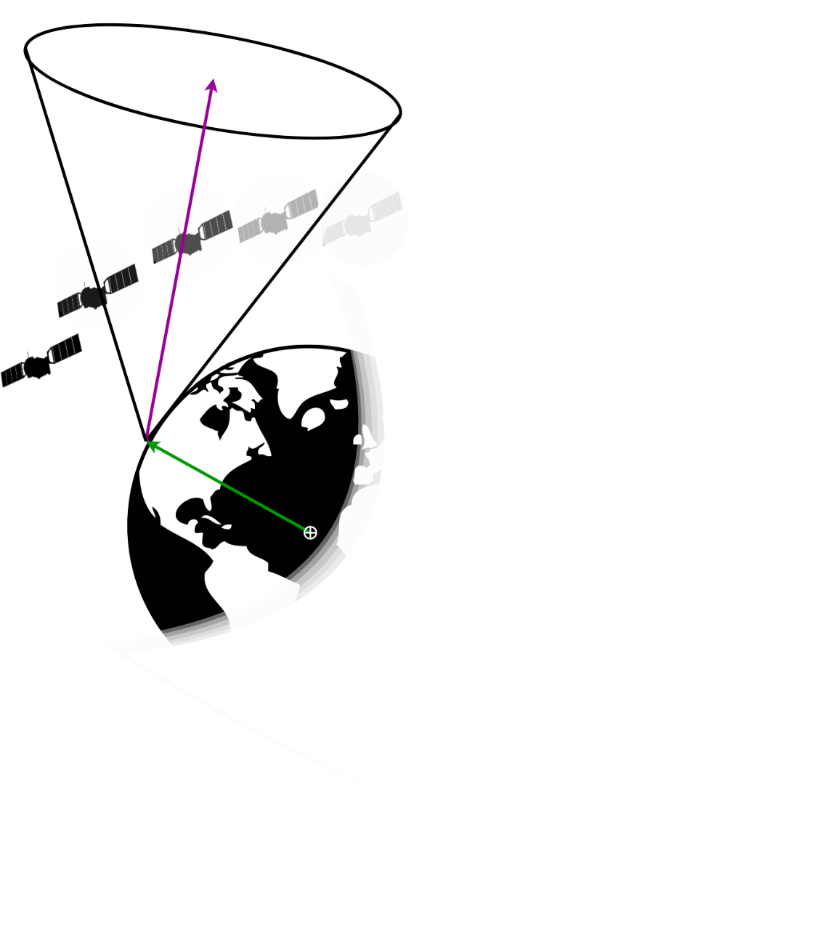
Optimizing Ground Sensor Placement
Dean Keithly Space Vehicles PhD Candidate Robert Sivilli
Probabilistically: How many spacecraft are in a Sensor FOV?
Probabilistic detection of spacecraft in a Sensor FOV?
Presenter: Dean Keithly

Slide 2
Process Diagram
Download data from the Unified Data Library, Jet Propulsion Laboratory, Ground Station Positions (blue)
Extract out Orbital Elements from TLE and calculated values
Model Probability Density Functions (PDF) and Joint PDF
Combine KOE into spacecraft distributions
Calculate Cone Volume Integrals
Presenter: Dean Keithly

Slide 3
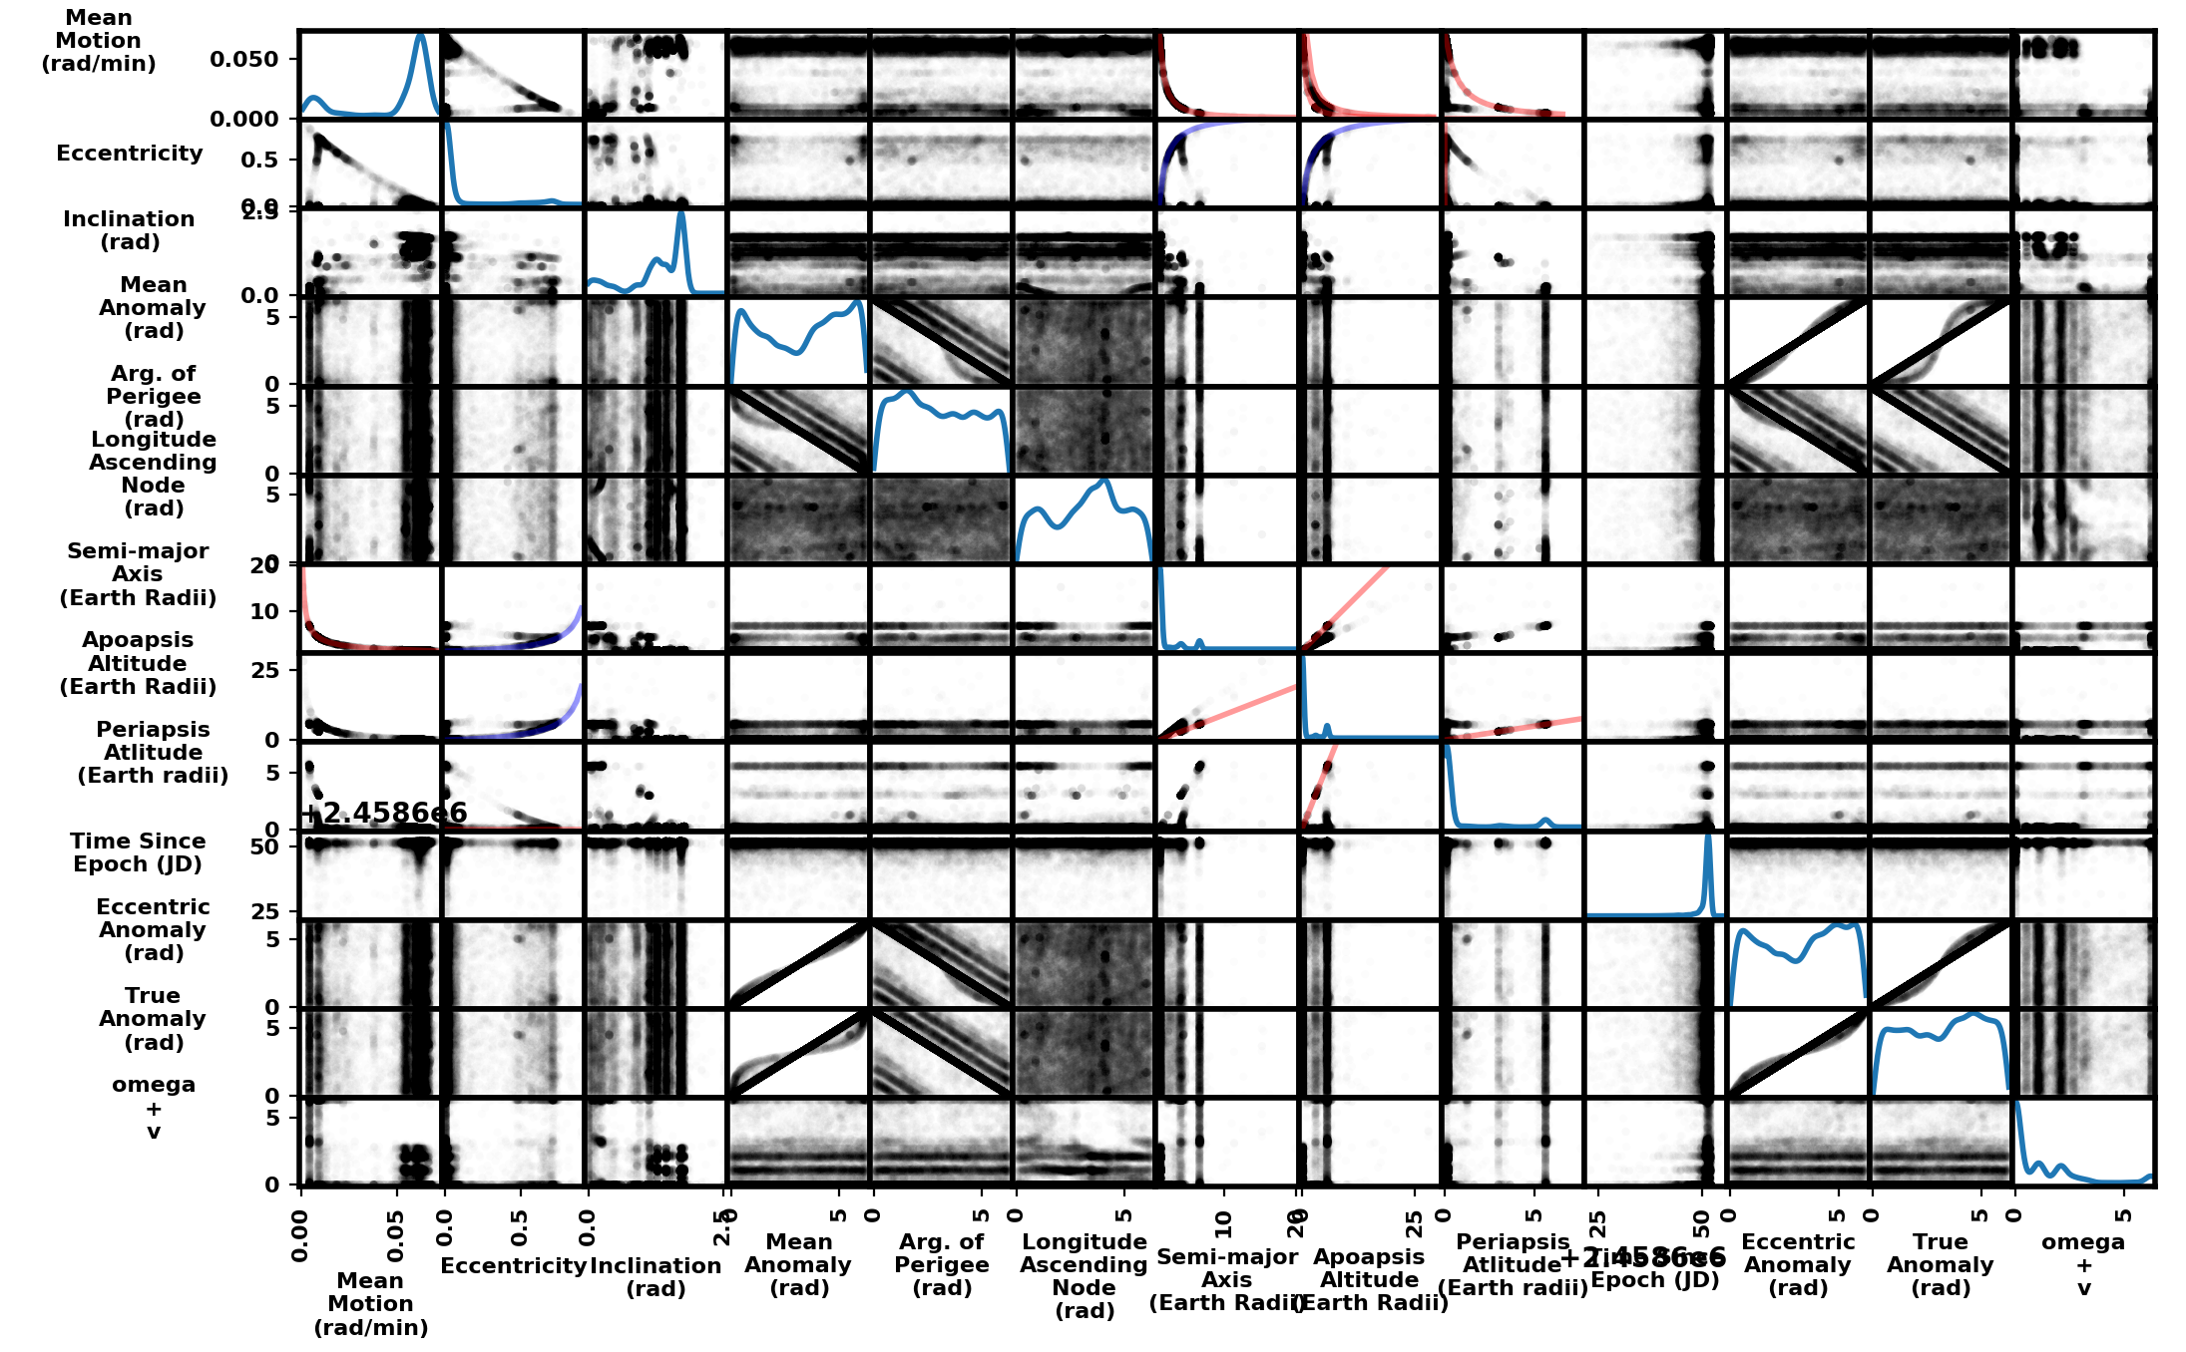
Keplerian Orbital Element
Inter-dependence
Along Diagonal: Kernel Density Estimates
(Probability Density Functions)
Each plot contains 17,966 spacecraft
Convert 5 (blue) scatter plots into joint probability distributions
Model PDFs w/ Rectilinear Bivariate Splines
Use eccentricity to drive sampling
Use Inverse Transform Sampling on Cumulative Distribution Function
Keplerian Orbital
Elements (KOE)
Joint Probability Density
Function Used
A ‘0’ slope indicates no dependence
Presenter: Dean Keithly

Slide 4
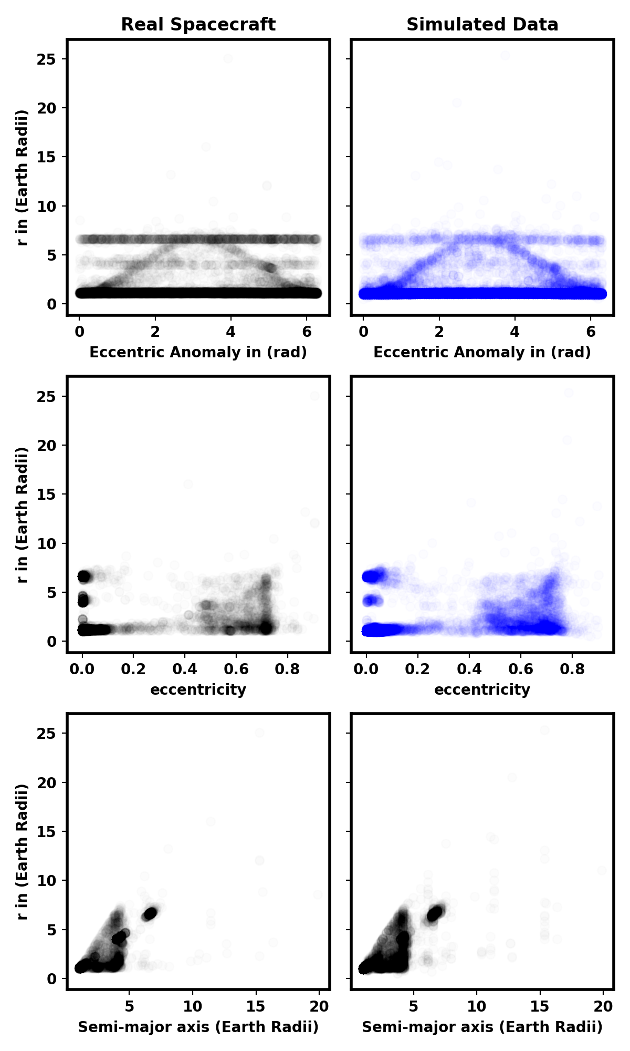
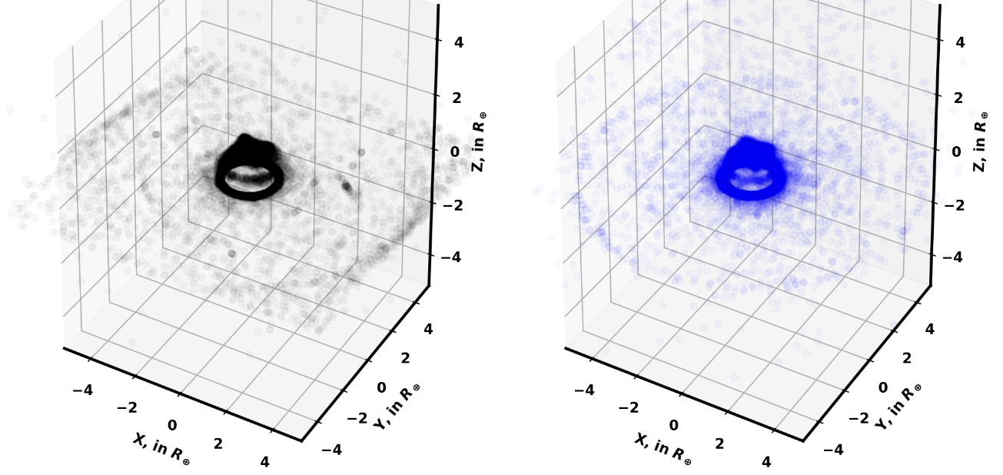

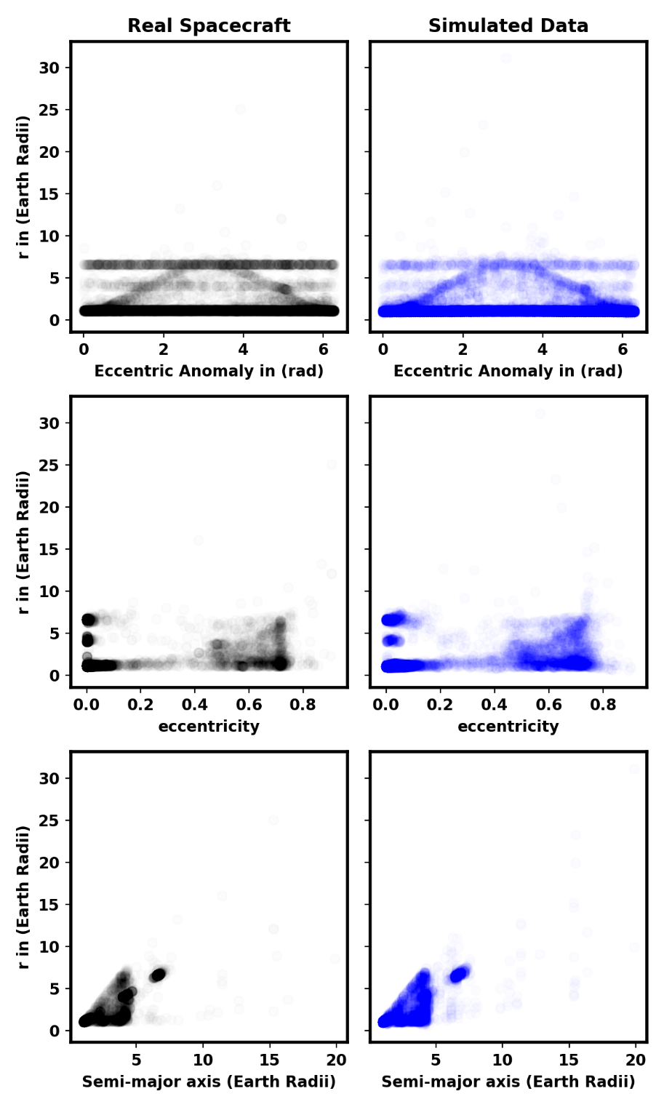
Simulating Spacecraft KOE
My sampling technique synthetically replicates underlying satellite state-vectors
Apparent ‘Fuzziness’ is caused by discretization of population space
Real SC: 17,966
Simulated SC: 20,000
Presenter: Dean Keithly

Slide 5
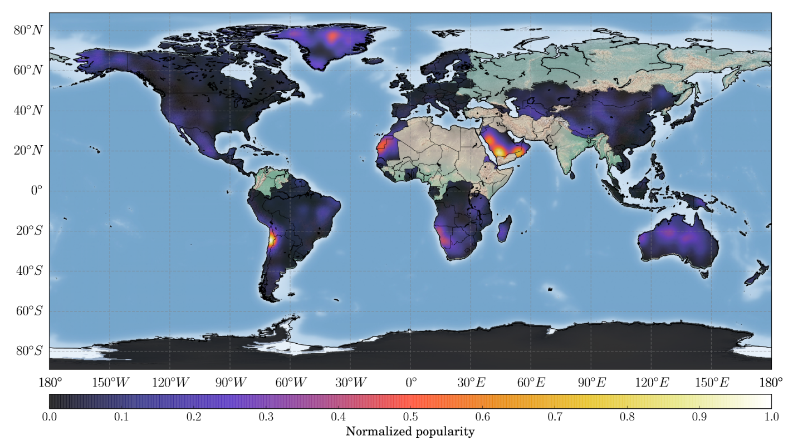
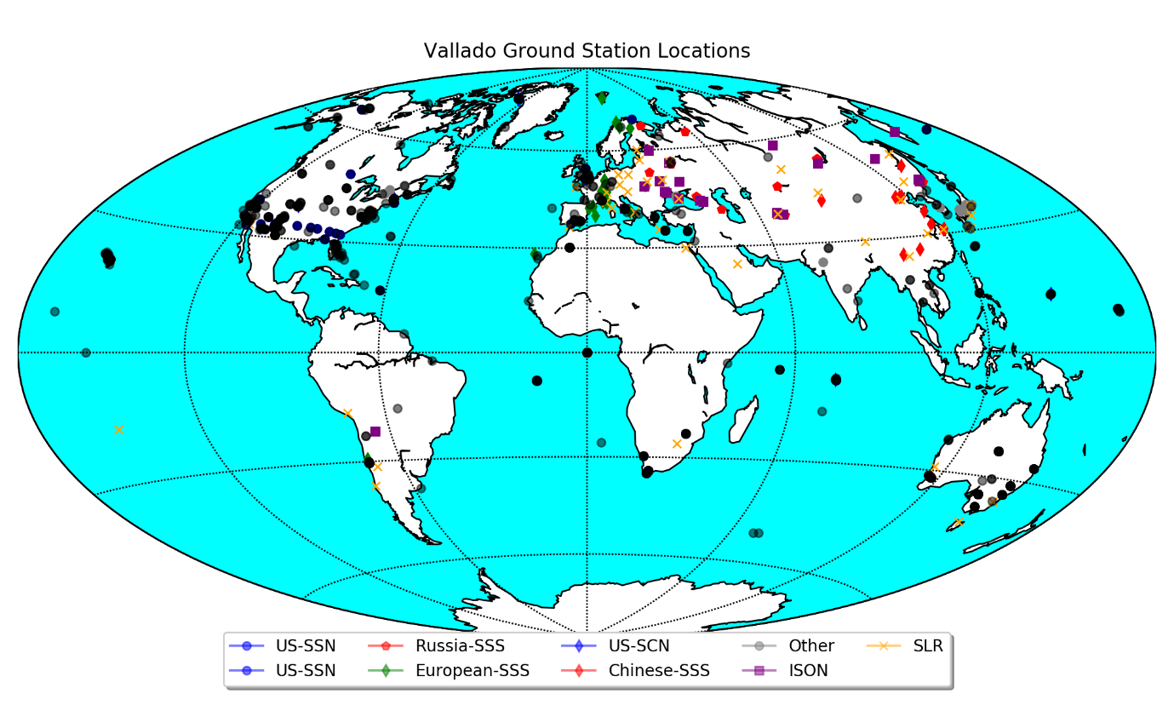
Ground Station Optimization
By combining:
Volume Integrals + Vmag integrals
At specific times
Over all elevations and azimuths
Of varying Sensors at Lat-Lon
Over previous probability distributions
We get:
Optimal observing Elevation-Azimuth for each Lat-Lon, t
Maximum expected number of spacecraft detections
Information where to place additional sensors
Utility of low capability sensors
*Results will look similar to this from Del Portillo 2017 Paper*
WHAT MORE COULD YOU ASK FOR BY WEEK 7 OF THE PROGRAM
Presenter: Dean Keithly

